Slide 1
DS 517– Lecture 2
Algorithms & Accountability
DS-517-50: Ethics and Bias in AI
2024 Fall
MONMOUTH CAMPUS
M 7:30 PM - 10:20 PM
9/3/2024 - 12/9/2024
Howard Hall, 309 LECTURE
Arup Das
adas@Monmouth.edu

Slide 2
Disclaimer:
The views expressed are solely those of the presenter and not affiliated with any other party.
This presentation is free of copyright violations, and external sources have been appropriately credited.
The content within this presentation is legally protected; unauthorized reproduction, including photography, will result in legal action.
This material is not intended for distribution and must remain solely within the confines of this class. Do not distribute slide or assignments to other students
Using cameras to take screenshots or photographs of the slides is strictly prohibited.
Notes:
Material is approximately 80% technical, 20% conceptual

Slide 3
Date | Week | Class Format/Location/Time | Topics | Readings Required (Due before class) | Assignment/Quiz
September 9, 2024 | Week_1 | On-Premise/Howard Hall, 309 LECTURE/7:30 PM-10:20PM | AI Ethics & Human-Centered Design
September 16,2024 | Week_2 | On-Premise/Howard Hall, 309 LECTURE/7:30 PM-10:20PM | Algorithms and Accountability | Book 1 – Chapter 1, 3, 9 | Assignment 1- Presentation on the professor assigned reading Due Sep 23,2024
September 23,2024 | Week_3 | On-Premise/Howard Hall, 309 LECTURE/7:30 PM-10:20PM | AIA/Transparency in AI | Book 1 – Chapter 4
September 30, 2024 | Week_4 | On-Premise/Howard Hall, 309 LECTURE/7:30 PM-10:20PM | Privacy, Security, and Inclusion | Book 1- Chapter 6, 7,8 | Assignment 2- Presentation on the professor-assigned reading Due Oct 7, 2024
October 7, 2024 | Week_5 | On-Premise/Howard Hall, 309 LECTURE/7:30 PM-10:20PM | AI Fairness & Bias | Book 1- Chapter 2 Book 2 – Chapter 8
October 14, 2024 | Week_6 | On-Premise/Howard Hall, 309 LECTURE/7:30 PM-10:20PM | AI Fairness & Bias | Book 2 – Chapter 8 | Assignment 3- Presentation on the professor-assigned reading Due Oct 21, 2024
October 21, 2024 | Week_7 | On-Premise/Howard Hall, 309 LECTURE/7:30 PM-10:20PM | AI Regulatory Frameworks (US and Europe) | Professor Handout
October 28,2024 | Week_8 | On-Premise/Howard Hall, 309 LECTURE/7:30 PM-10:20PM | AI Regulatory Frameworks (Continued) | Professor Handout | Assignment 4 - Presentation on the professor-assigned reading Due Nov4,2024
November 4, 2024 | Week_9 | On-Premise/Howard Hall, 309 LECTURE/7:30 PM-10:20PM | Explainable AI - Introduction to Model Interpretability | Book 2 – Chapter 1 ,2
November 11, 2024 | Week_10 | On-Premise/Howard Hall, 309 LECTURE/7:30 PM-10:20PM | Explainable AI - Advanced Topics | Book 2 – Chapter 3, 4 ,5 | Coding Assignment – Due Nov 22, 2024
November 18,2024 | Week_11 | On-Premise/Howard Hall, 309 LECTURE/7:30 PM-10:20PM | Case Studies in Explainable AI | Book2 – Chapter 6,7
November 25, 2024 | Week_12 | On-Premise/Howard Hall, 309 LECTURE/7:30 PM-10:20PM | AI Ethics in Practice | Book 2 – Chapter 9
December 2, 2024 (Last class) | Week_13 &14 | On-Premise/Howard Hall, 309 LECTURE/7:30 PM-10:20 PM | AI Ethics Case Essay Preparation/Final Exam and Course Wrap-Up |  | Final Essay, Final Exam Due Dec 8, 2024, before midnight EST

Slide 4
Course Logistics
OneDrive link for professor notes and assignments/quiz -
Check your Monmouth email for announcements
Check your Monmouth calendar for Zoom links for office hours and remote lectures
My contact information: adas@monmouth.edu, Cell # 917-523-7683
Office hours (zoom only) – Friday (EST)
Assignment submission to professoraruprdas@gmail.com ( Notation for files: Assignment_1_Name_of_Student), Colab notebooks ipynb file and html file, all presentation in ppt format.
Quiz submission to professoraruprdas@gmail.com (Notation for file : Quiz_1_Name_of_Student. doc , Quiz_2_Name_of_Student.doc)
Deep Learning with Python

Slide 5
Topics
Algorithms and Accountability
Accountability Legislature
AIA – Algorithm Impact Assessment
Deep Learning with Python

Slide 6
Lecture 1 Recap

Slide 7
AI Ethics
AI Ethics is a subfield of Applied Ethics.
Part of the ethics of technology specific to robots and other artificially intelligent entities
Concerns question how developers, manufacturers, and corporations should behave to minimize the ethical risks that can arise from AI in society
Minimize ethical risk concerns:
Design
Inappropriate application
Misuse of technology
Deep Learning with Python
ML Algorithm (Software)
ML Applications
ML Robots

Slide 8
Ethical Reasoning - Five Ethical Lenses ( AI Ethics is a sub-field of Ethics)
Right approach – Which option best respects the rights of all who have stakes
Justice approach – Which option treats people equally or proportionately
Utilitarian approach – Which option will produce the best and do the least harm
Common good approach – Which option best serves the community as a whole and not just members
Virtue approach – Which option leads me to act as the sort of person I want to be
Deep Learning with Python
https://www.scu.edu/media/ethics-center/technology-ethics/Tech_and_Engineering_Practice-Ethical_Lenses-2022.pdf

Slide 9
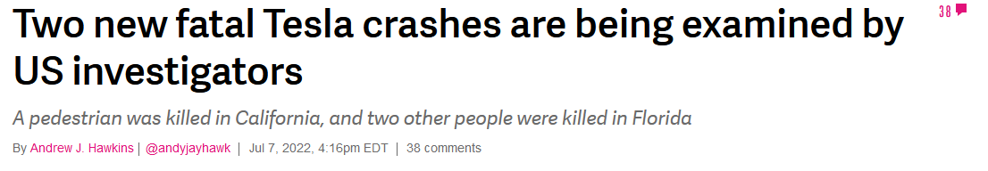
The principle of Common Good
Beneficence
Non-maleficence
Deep Learning with Python
Do Good
Creation of beneficial AI ( AI creation for common good and the benefit of humanity)
Do no harm
Non-maleficence negative consequences of AI and risks of AI
AI ethics primarily focused here.
https://www.theverge.com/2022/7/7/23198997/tesla-fatal-crashes-california-florida-autopilot-nhtsa

Slide 10
AI Ethics 5 Core Principles
Non-Maleficence (Avoid Harm)
Responsbility or Accountability
Transparency or Explainability
Justice or Fairness
Human rights – Privacy and Security
Deep Learning with Python
https://arxiv.org/ftp/arxiv/papers/1906/1906.11668.pdf

Slide 11
AI Ethics 5 Core Principles Questions
Should we use AI for good and not for causing harm? (the principle of beneficence/ non-maleficence)
Who should be blamed when AI causes harm? (the principle of accountability)
Should we understand what and why AI does whatever it does? (the principle of transparency)
Should AI be fair or non-discriminative? (the principle of fairness)
Should AI respect and promote human rights? (the principle of respecting fundamental human rights)
Deep Learning with Python
https://arxiv.org/ftp/arxiv/papers/1906/1906.11668.pdf

Slide 12
Human Centered Design
Human-centered design (HCD) is an approach to designing systems that serve people’s needs.
HCD involves people in every step of the design process. Your team should adopt an HCD approach to AI as early as possible - ideally, from when you begin to entertain the possibility of building an AI system.

Slide 13
Industry Viewpoint

Slide 14

"Godfather of AI" Geoffrey Hinton: The 60 Minutes Interview – 13min
There’s no guaranteed path to safety as artificial intelligence advances, Geoffrey Hinton, AI pioneer, warns. He shares his thoughts on AI’s benefits and dangers with Scott Pelley.
https://www.youtube.com/watch?v=qrvK_KuIeJk

Slide 15
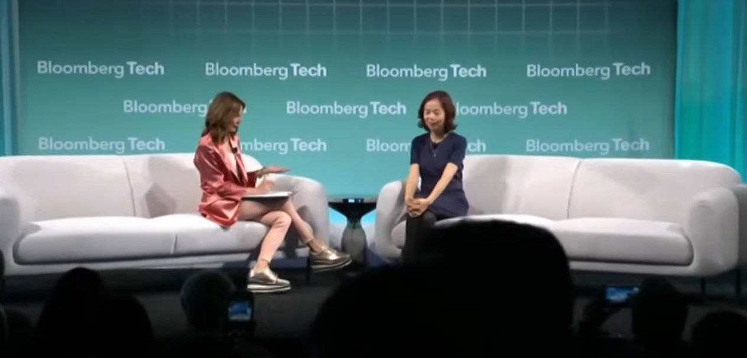
Top Researcher Li on the Promises and Perils of AI – 15 min
Fei-Fei Li, Sequoia Professor in Computer Science & Co-Director Human-Centered AI Institute, Stanford University speaks with Bloomberg’s Emily Chang about AI and ethics at Bloomberg Tech in San Francisco.
https://www.youtube.com/watch?v=FW5CypL1XOY

Slide 16
Algorithms and Accountability
What does accountability actually mean, and how does it apply to AI ethics?

Slide 17
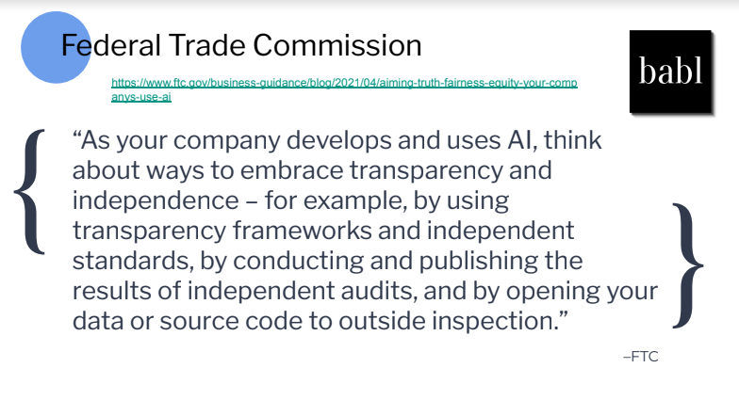
FTC

Slide 18
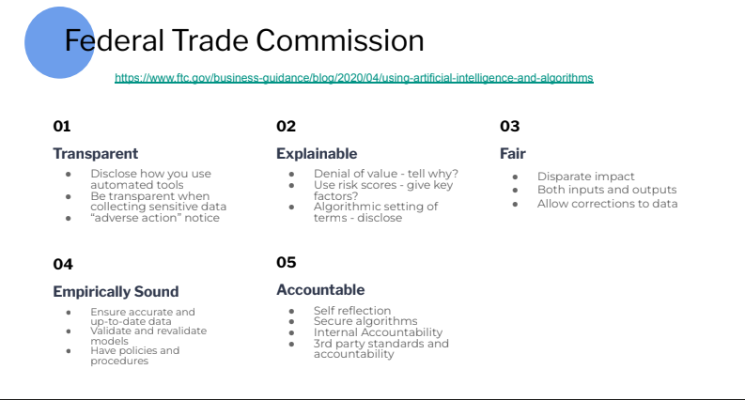
FTC
https://www.ftc.gov/business-guidance/blog/2020/04/using-artificial-intelligence-algorithms

Slide 19
Accountability
Who should be blamed?
What does accountability actually mean, and how does it apply to AI ethics? We’ll also discuss what moral agency and responsibility mean and the difficulty of assigning blame.

Slide 20
Algorithms and accountability
What are Algorithms ???
They are nothing but software based statistical models created by human for decision making- Fully Automated, Semi-automated

Slide 21
Algorithms Can Make Errors
Algorithms are exact, fast and precise, they often promote better service efficiency, reliability and consistency
Paradoxically, algorithms can also make systematic errors, be biased and cause serious harms
Self Driving car crashes
Wrong decision for parole
People denied credit

Slide 22
Algorithms Can Make Errors – Who is Responsible
When AI Algorithms get it wrong causing damage who is accountable ?????
It was the algorithm’s fault and it is responsible for the wrong decision", we do not literally mean that contemporary algorithms would be morally guilty. Instead, the algorithms are causal factors that underlie the decisions
Even though algorithms themselves cannot be held accountable as they are not moral or legal agents, the organizations designing and deploying algorithms can be taken to be morally responsible through governance structures

Slide 23
What is accountability?
Accountability means the state of being responsible or answerable for a system, its behavior, and its potential impacts. Accountability is an acknowledgement of responsibility for actions, decisions, and products.
Responsibility can be legal or moral (ethical). Legally, an actor is responsible for an event when a legal system is liable to penalize that actor for that event.
Morally, an actor is responsible for an act, if they can be blamed for the action. Moral and legal responsibility are different things. They do not always coincide; an agent can be legally responsible even if they were not morally responsible, and vice versa. In this lecture, we´ll focus only on moral aspects of responsibility.

Slide 24
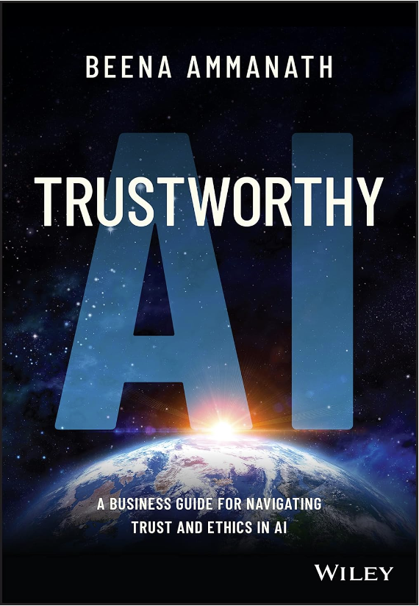
What is accountability?- Accountable Page 149 Book 1
“Accountability means that not only can the AI system explain its decisions, the stakeholders who develop and use the system can also explain its decisions, their own decisions, and understand that they are accountable for those decisions”

Slide 25
What is accountability? AI Ethic Dimensions
In AI ethics, there are three different senses or dimensions of accountability. They point to a different means of action including:
The question of determining the responsibility :
Which individuals (or groups) are accountable for the impact of algorithms or AI? Who is responsible for what effect within the overall socio-technical system?
A feature of the societal system that develops, produces, and uses AI
A feature of the AI system itself

Slide 26
Who should be blamed – and for what?
In ethics, accountability is closely related to the concept of “moral agency”. A moral agent is “an agent who is capable of acting with reference to right and wrong." Importantly, only moral agents are morally responsible for their actions.

Slide 27
Algorithmic accountability
Algorithmic accountability is the concept that companies should be held responsible for the results of their programmed algorithms. The concept goes hand in hand with algorithmic transparency, which requires companies be open about the purpose, structure and underlying actions of the algorithms used to search for, process and deliver information.
As the product of humans, algorithms can have issues resulting from human bias or simple oversight. Algorithmic accountability is promoted as a way to help such issues be recognized and corrected.
https://www.techtarget.com/searchenterpriseai/definition/algorithmic-accountability/

Slide 28
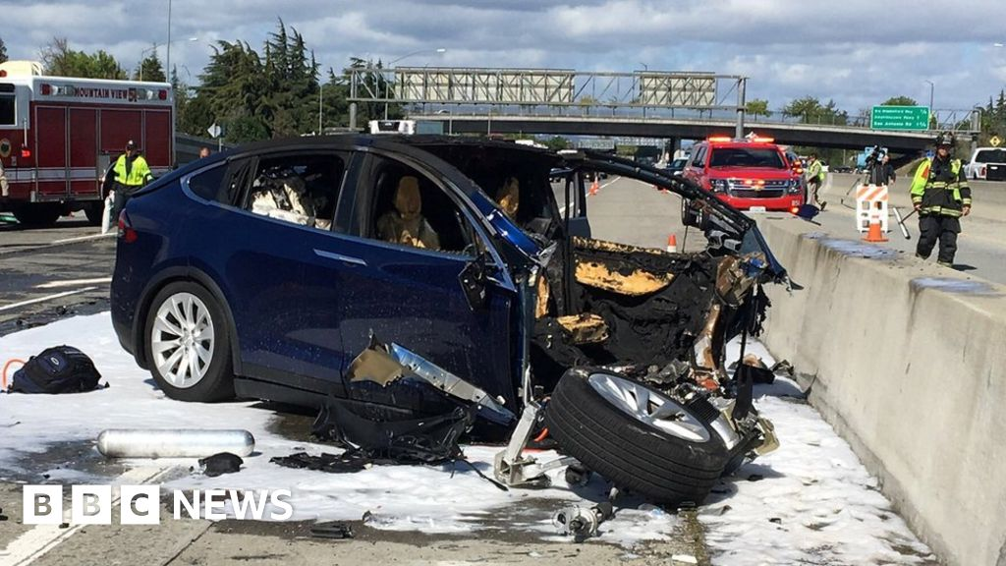
Who is responsible in a Tesla Car Cash - Autonomous Driving
Tesla Autopilot crashes is a complex issue, but generally:The driver is typically considered primarily responsible in most cases.
Key points:
Tesla emphasizes that Autopilot is an assistive feature, not fully autonomous driving. Drivers are expected to remain attentive and in control of the vehicle at all times.
Tesla's terms of use explicitly state drivers must keep hands on the wheel and maintain control, which could absolve Tesla of liability if not followed.
Driver error, over-reliance on Autopilot, reckless driving, or driving under the influence can lead to driver liability.
In a recent court case, Tesla won by arguing the fatal crash was the driver's fault for misusing Autopilot.
However, Tesla and manufacturers may face some liability in certain circumstances:
If there are defects in design, manufacturing, or inadequate warnings about the system.
Malfunctions like errant steering or braking issues could potentially implicate the manufacturer.
Some experts believe liability may shift more to manufacturers as vehicles become more autonomous.
Tesla is facing investigations and potential fines from regulators like NHTSA over Autopilot safety.
Ultimately, liability is often determined case-by-case based on the specific circumstances. Both criminal charges against drivers and civil lawsuits against Tesla have occurred in some high-profile crashes. As the technology and regulations evolve, the legal landscape around liability for self-driving car accidents continues to develop
https://byrddavis.com/who-is-liable-when-a-self-driving-car-causes-a-crash/
https://www.tesla.com/VehicleSafetyReport

Slide 29
Algorithmic accountability – Semi-Autonomous Driving
0:01 / 3:25
Tesla cars linked to hundreds of crashes in federal report | KVUE
https://www.youtube.com/watch?v=kwf5F7Lze3A
https://www.youtube.com/watch?v=jSC5qSKmc8Q

Slide 30
Industry Viewpoint

Slide 31
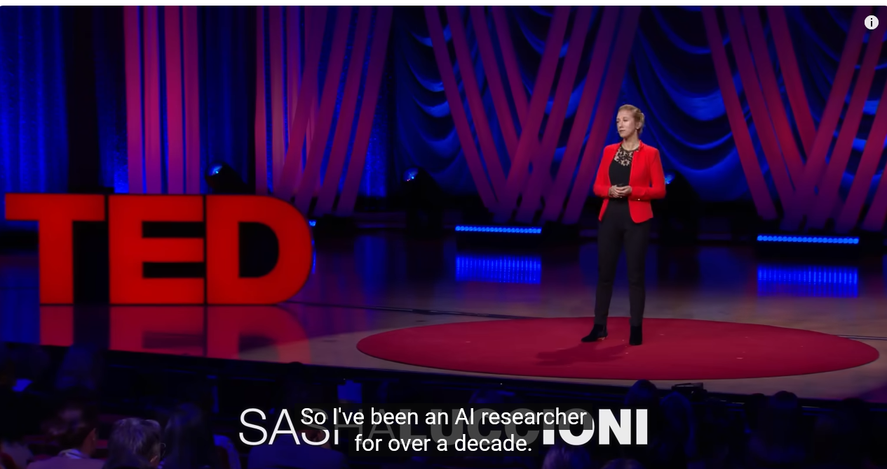
AI Is Dangerous, but Not for the Reasons You Think | Sasha Luccioni | TED – 10 min
AI won't kill us all — but that doesn't make it trustworthy. Instead of getting distracted by future existential risks, AI ethics researcher Sasha Luccioni thinks we need to focus on the technology's current negative impacts, like emitting carbon, infringing copyrights and spreading biased information. She offers practical solutions to regulate our AI-filled future — so it's inclusive and transparent.
https://www.youtube.com/watch?v=eXdVDhOGqoE

Slide 32
Module 2: Algorithms and Accountability Legislature

Slide 33
What does algorithmic accountability mean
Algorithmic accountability means the process of holding some entities responsible or accountable in cases where the algorithms they develop or operate make decisions that result in unfair outcomes.
Puts the onus of whether your algorithm is unfairly biased towards some populations on those using the algorithm for their decision making. Making significant efforts to determine the efficacy and identify any unintended biases is a key part of algorithm development and becomes especially important for decisions that make a significant impact on a person’s life such as whether to give someone a job or mortgage.
https://www.bu.edu/hic/2022/02/15/ask-the-experts-what-is-algorithmic-accountability/

Slide 34
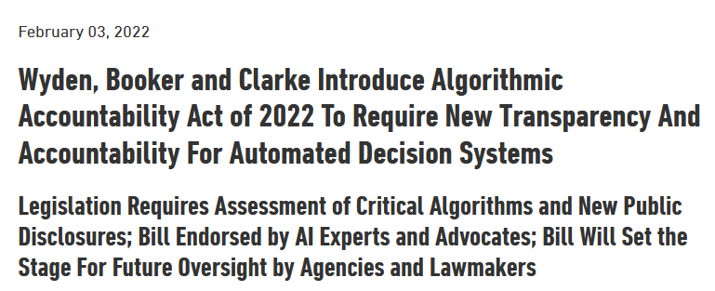
Accountability Act of 2022
https://www.wyden.senate.gov/news/press-releases/wyden-booker-and-clarke-introduce-algorithmic-accountability-act-of-2022-to-require-new-transparency-and-accountability-for-automated-decision-systems#:~:text=%E2%80%93%20U.S.%20Senator%20Ron%20Wyden%2C%20D,used%20to%20make%20critical%20decisions

Slide 35
Accountability Act of 2022 - Highlights
Bring new transparency and oversight of software, algorithms and other automated systems that are used to make critical decisions about nearly every aspect of Americans’ lives.
The bill will pull back the curtain on the secret algorithms that can decide whether Americans get to see a doctor, rent a house or get into a school
With our renewed Algorithmic Accountability Act, large companies will no longer be able to turn a blind eye towards the deleterious impact of their automated systems, intended or not. We must ensure that our 21st Century technologies become tools of empowerment, rather than marginalization and seclusion.”

Slide 36
Accountability Act of 2022 - Highlights
The bill requires companies to conduct impact assessments for bias, effectiveness and other factors, when using automated decision systems to make critical decisions.
It also creates, for the first time, a public repository at the Federal Trade Commission of these systems, and adds 75 staff to the commission to enforce the law.

Slide 37
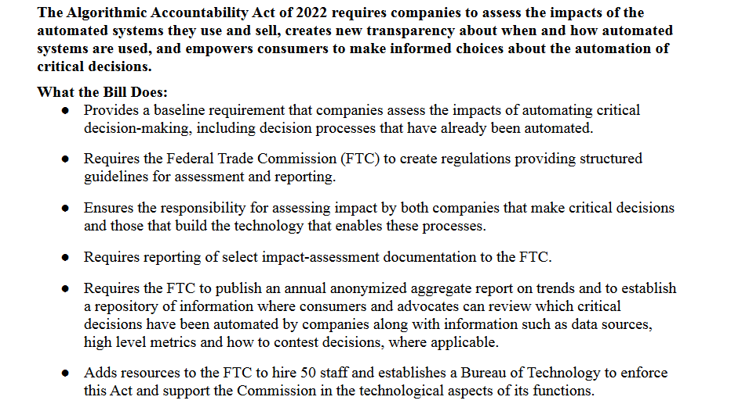
Accountability Act of 2022 - Highlights

Slide 38
Algorithmic Accountability Act of 2022 will reduce biases?
A policy that sets up the mechanisms to examine and assess algorithms for biases will encourage efforts to reduce biases in the development and deployment of these models. In doing so, it will improve the transparency of these algorithms and hold developers or operators of the algorithms accountable for harm caused by biased predictions of their algorithms.
There are technical challenges including deciding what metrics are best used to assess algorithm bias and which part of the algorithms should be assessed in the case of a pipeline of algorithms. There are the practical challenges, such as whether it is the development or the deployment of these algorithms that should be assessed
https://www.bu.edu/hic/2022/02/15/ask-the-experts-what-is-algorithmic-accountability/

Slide 39

Module 2: Algorithm Impact Assessment

Slide 40
What is an AIA?
What is an AIA? An Algorithmic Impact Assessment is a tool for identifying the potential societal impacts of an algorithmic system before it’s launched.
AIAs are very much in the early stages of development, and as such there’s no standard methodology on how to put one together yet. However, there’s huge interest in tools like AIAs — they have so far been mostly proposed for public sector use, and there is already one ‘live’ example of an AIA tool being used in the Canadian government. So in these early stages, it’s important to consider the potential use-cases for AIAs.
https://www.hattusia.com/post/accountability-in-ai-algorithmic-impact-assessments-jenny-brennan-lara-groves

Slide 41
AN INSTITUTIONAL VIEW OF ALGORITHMIC IMPACT ASSESSMENTS
An Algorithmic Impact Assessment is a process in which the developer of an algorithmic system aims to anticipate, test, and investigate potential harms of the system before implementation; document
those findings; and then either publicize them or report them to a regulator.
https://jolt.law.harvard.edu/assets/articlePDFs/v35/Selbst-An-Institutional-View-of-Algorithmic-Impact-Assessments.pdf

Slide 42
Why we need AIA ????
The precise mechanisms for the known algorithmic harms are not yet understood and the ways to prevent or mitigate the harms are not obvious.
Perhaps one day more straightforward regulation of specific harmful mechanisms will be appropriate, but a regime of documentation and knowledge production is necessary before we can get to that point, and some forced introspection and disclosure on the part of the producers of the harms can help in the meantime
Three commonly discussed harms — discrimination, procedural injustice, and physical injury.
https://jolt.law.harvard.edu/assets/articlePDFs/v35/Selbst-An-Institutional-View-of-Algorithmic-Impact-Assessments.pdf

Slide 43
The Discriminatory Hiring Algorithm
Discrimination is easily the most recognized and discussed harm of algorithmic decision making. Biased results that harm members of protected classes are a concern wherever algorithms are used to allocate opportunities
Employment, Credit, Housing, policing, pre-trial detention and sentencing
https://jolt.law.harvard.edu/assets/articlePDFs/v35/Selbst-An-Institutional-View-of-Algorithmic-Impact-Assessments.pdf

Slide 44
The Unexplained Loan Denial
Algorithmic harm is the unexplained adverse result, the fate sealed by an inscrutable black box
The most frequent example is a denial of a loan, but other benefits, such as unemployment insurance or Medicaid disbursements, also fall into this category
https://jolt.law.harvard.edu/assets/articlePDFs/v35/Selbst-An-Institutional-View-of-Algorithmic-Impact-Assessments.pdf

Slide 45
The Unsafe Medical AI
Use of AI in medical disease detection and the harm done if the diagnosis is wrong
https://jolt.law.harvard.edu/assets/articlePDFs/v35/Selbst-An-Institutional-View-of-Algorithmic-Impact-Assessments.pdf

Slide 46
ALGORITHMIC IMPACT ASSESSMENTS
AIA impact assessment fall into three models:
Models based on NEPA
Models based on the GDPR’s DPIA
Questionnaire models
https://jolt.law.harvard.edu/assets/articlePDFs/v35/Selbst-An-Institutional-View-of-Algorithmic-Impact-Assessments.pdf

Slide 47
ALGORITHMIC IMPACT ASSESSMENTS- NEPA
The National Environmental Policy Act is a United States environmental law that promotes the enhancement of the environment and established the President's Council on Environmental Quality
The NEPA model implies a highly detailed impact assessment, potentially running to hundreds of pages. It demands thorough answers to open-ended questions that explain the design process. Other features of the NEPA model are transparency and public participation via a notice and comment framework. Be-cause transparency, and specifically notice and comment frameworks, are part of the regulation that is usually applied to the public sector in the United States, it is perhaps not surprising that these proposals tend to focus on the public sector, rather than the private sector.
https://jolt.law.harvard.edu/assets/articlePDFs/v35/Selbst-An-Institutional-View-of-Algorithmic-Impact-Assessments.pdf

Slide 48
ALGORITHMIC IMPACT ASSESSMENTS- GDPR/DPIA
AIA draws on European data protection law. Article 35 of the GDPR requires companies to perform DPIAs whenever data processing “is likely to result in a high risk to the rights and freedoms of natural persons.
The DPIA envisions a similarly expansive scope of work to the NEPA model, including a “systematic description” of the processing, justifications, and plans for mitigation.
One difference from the NEPA approach is that there is no explicit requirement to describe all the reasonable and rejected choices. The only requirement is to sys-tematically evaluate the actual program that is to go forward.
In practice, however, the requirement to show all the “measures envisaged” to mitigate dangers might be broad enough to encompass the same idea.122 The most significant difference is in transparency.
Although the official guidance on DPIAs recommends making a summary of the DPIA public, publication — of even a summary — is not re-quired.123 Instead DPIAs are performed in collaboration with member
https://jolt.law.harvard.edu/assets/articlePDFs/v35/Selbst-An-Institutional-View-of-Algorithmic-Impact-Assessments.pdf

Slide 49
ALGORITHMIC IMPACT ASSESSMENTS- Questionnaire Based
The third approach is the one taken by the government of Canada. Under Canada’s Directive on Automated Decision-Making, government agencies that use algorithmic decision making must complete an AIA both before production and before the project goes live. The AIA consists of “around 60 questions related to [] business process, data and system designed decisions.”126
The questions touch on most of the topics people care about with respect to algorithms. Some of the questions go to the thoughts behind the process (e.g., “What is motivating your team to introduce automation into this decision-making process? (Check all that apply),”with choices related to backlog, efficiency, quality, and being innovative).Other questions ask about the stakes of the decisions, the sec-tor, the degree of explanation or human involvement, and so on. Each of these questions receive a point total. That point total then determines whether the overall risk falls within one of four wide bands (Impact Levels I–IV), and agencies implementing algorithmic system that fall within a given band must take certain increasingly involved remedial actions to mitigate the anticipated harms. While most of the questions are multiple choice, some do include written answers.131 The written answers are not scored, but can be made public.13
https://jolt.law.harvard.edu/assets/articlePDFs/v35/Selbst-An-Institutional-View-of-Algorithmic-Impact-Assessments.pdf

Slide 50
Importance of AIA
Early Intervention – Early stage interventions to inform projects before they are built. (The NEPA and DPIA models require completion of the AIA before deployment of the project. The Canadian AIA is meant to be filled out before design and again after implementation)
Open Ended Questions - An effective AIA must ask open-ended questions, inviting bot-tom-up explanations. The algorithmic systems of interest are highly complex and far from fully understood
Accountability – Legal requirement
https://jolt.law.harvard.edu/assets/articlePDFs/v35/Selbst-An-Institutional-View-of-Algorithmic-Impact-Assessments.pdf

Slide 51
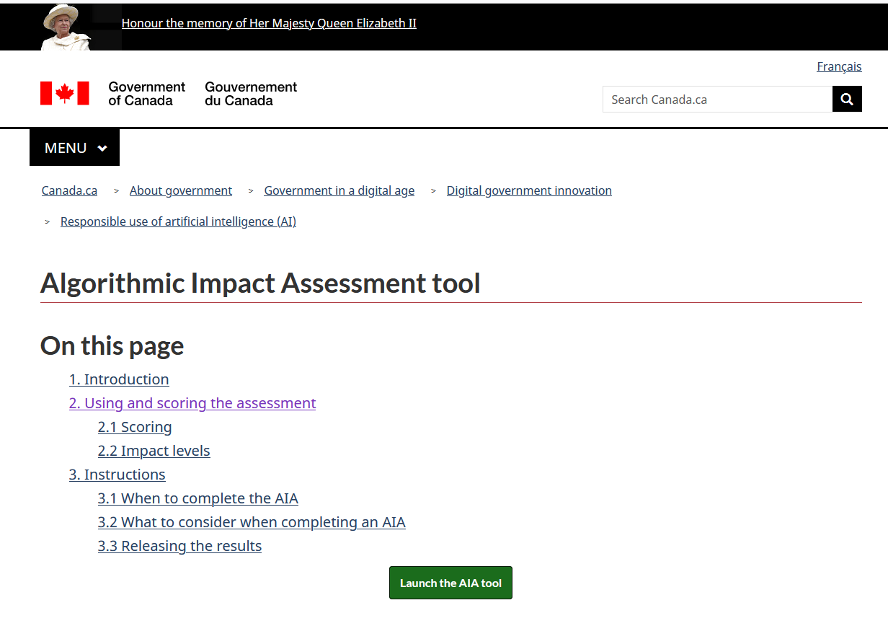
Canada - Algorithmic Impact Assessment tool
https://www.canada.ca/en/government/system/digital-government/digital-government-innovations/responsible-use-ai/algorithmic-impact-assessment.html

Slide 52
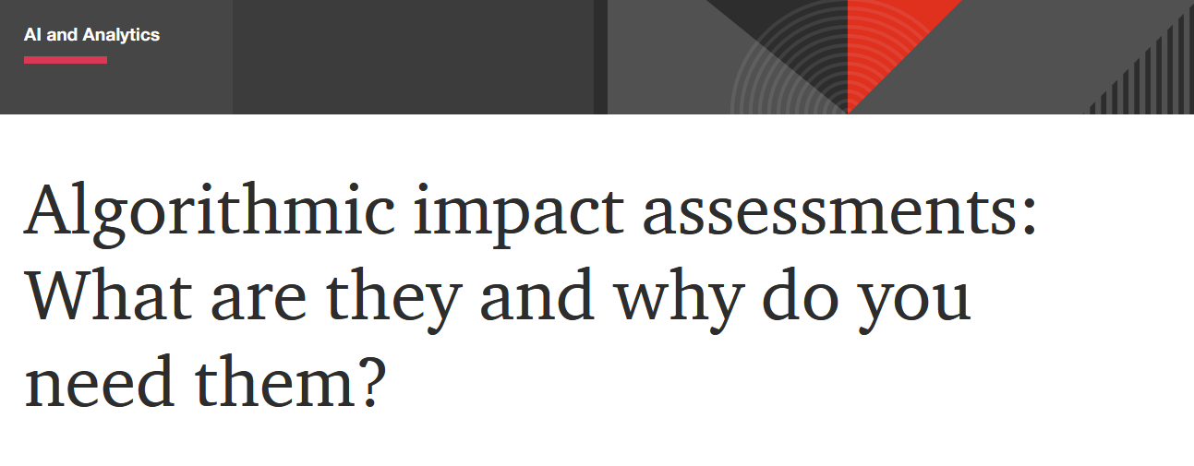
Algorithmic impact assessments: What are they and why do you need them?
https://www.pwc.com/us/en/tech-effect/ai-analytics/algorithmic-impact-assessments.html

Slide 53
Industry Viewpoint

Slide 54
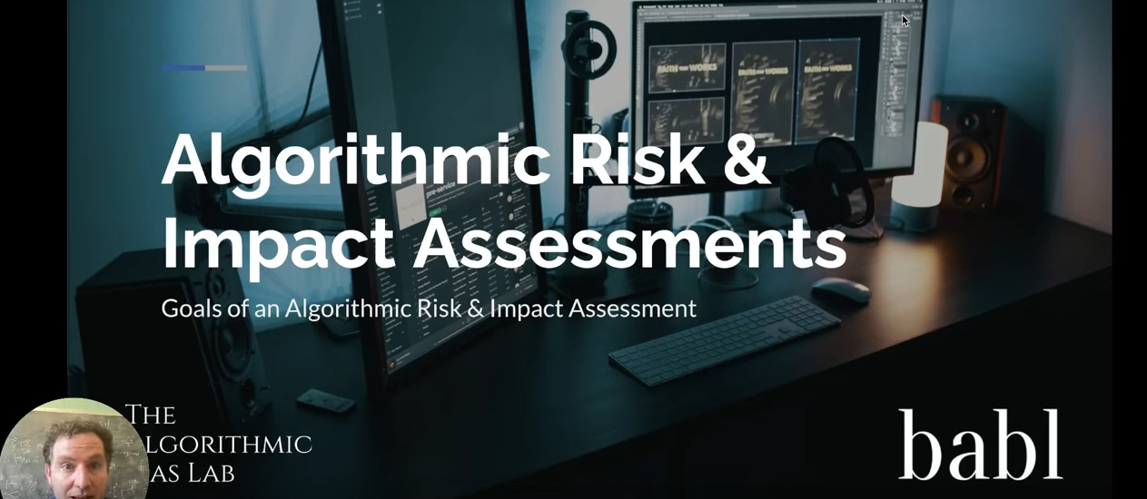
Algorithmic Risk & Impact Assessments – 10min
From the Algorithmic Risk & Impact Assessment Course offered by The Algorithmic Bias Lab, the research and education division of BABL AI Inc. These assessments are a critical component of most forthcoming regulations and standards for the governance of AI systems, including: EU AI Act Digital Services Act NIST AI Risk Management Framework ISO/IEC 42001
https://www.youtube.com/watch?v=J3HMCqCS6zE
https://www.youtube.com/@bablai/videos

Slide 55
Appendix

